Slide 1
Millikan Oil Drop Experiment
By
Dr. Sikander M. Mirza
Department of Physics & Applied Mathematics
Pakistan Institute of Engineering & Applied Sciences
Nilore, Islamabad 45650, Pakistan

Slide 2
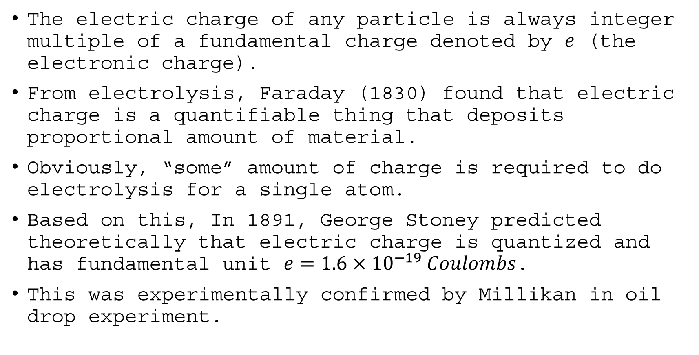
Introduction
The electric charge of any particle is always integer multiple of a fundamental charge denoted by $e$ (the electronic charge).
From electrolysis, Faraday (1830) found that electric charge is a quantifiable thing that deposits proportional amount of material.
Obviously, “some” amount of charge is required to do electrolysis for a single atom.
Based on this, In 1891, George Stoney predicted theoretically that electric charge is quantized and has fundamental unit $e=1.6×{10}^{−19} Coulombs$.
This was experimentally confirmed by Millikan in oil drop experiment.

Slide 3
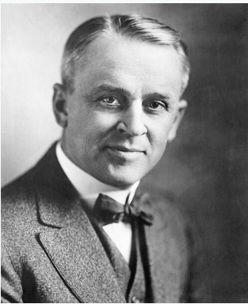
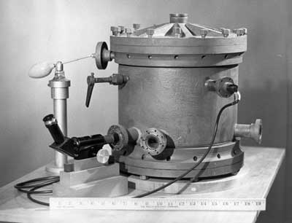
Introduction
Millikan Oil Drop Experiment

Slide 4
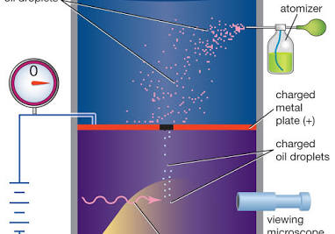
Introduction

Slide 5
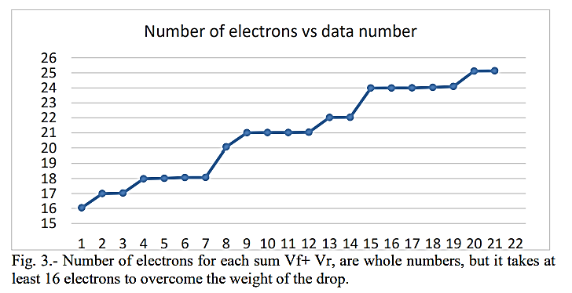
Introduction

Slide 6
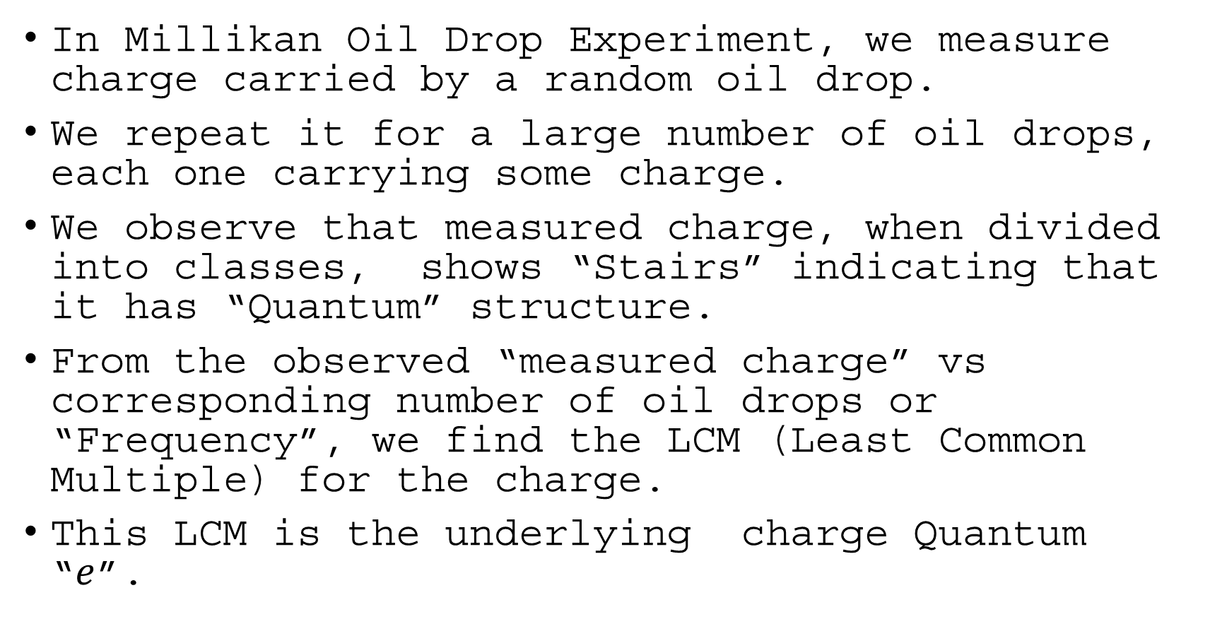
Introduction
In Millikan Oil Drop Experiment, we measure charge carried by a random oil drop.
We repeat it for a large number of oil drops, each one carrying some charge.
We observe that measured charge, when divided into classes, shows “Stairs” indicating that it has “Quantum” structure.
From the observed “measured charge” vs corresponding number of oil drops or “Frequency”, we find the LCM (Least Common Multiple) for the charge.
This LCM is the underlying charge Quantum “$e$”.

Slide 7
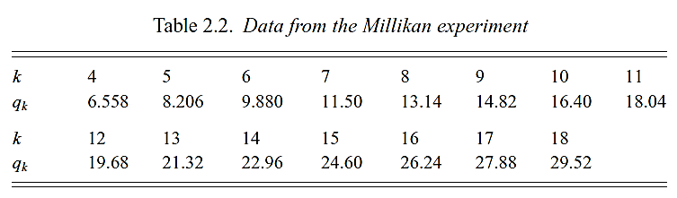
Introduction
Let us look at the following data. We are “not” looking for the LCM this time for the charge.
We will fit a straight line to this data and look at the “y-intercept”.
For curve fitting, we do least square calculations.

Slide 8
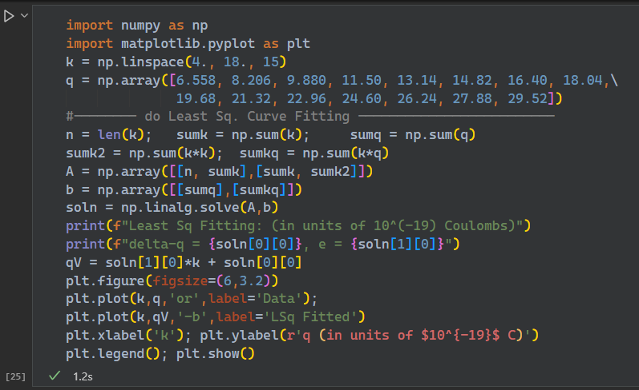
Introduction

Slide 9
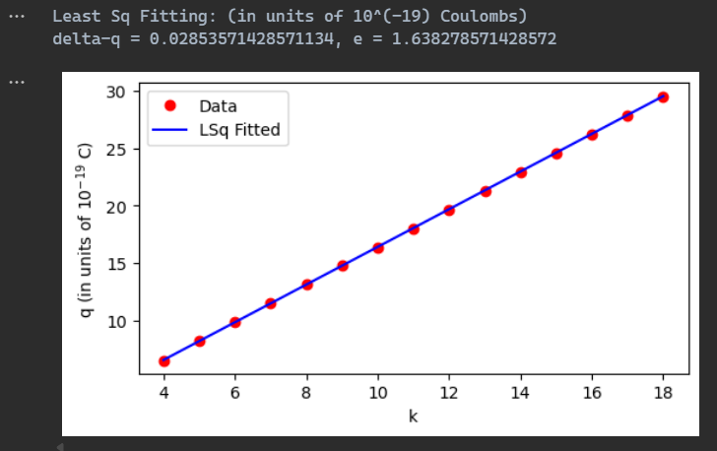

Introduction

Slide 10
